Slide 1

A Capstone Project on
Travel App
&
Code Playground

Slide 2

Submitted by
Name: Kaushik Mandaloju
Batch: Wipro Salesforce B13 (WIP-SF-13)
LMS ID: MGSA_532
Date: 27-02-2023

Slide 3

CONTENT
Ø INTRODUCTION TO SALESFORCE
Ø MODULE 1
Ø MODULE 2
Ø MODULE 3

Slide 4

INTRODUCTION TO SALESFORCE
◆ Salesforce is a cloud-based software company that provides
its customers with a platform to develop their own
applications without following the tough steps that they
used to follow in the legacy system. The software or
application once created can be uploaded onto the cloud
allowing the end-users to view them.
◆ Salesforce is currently providing various software solutions
and platforms for developers to create and distribute
custom software/applications. Tech giants like Google,
Twitter, Amazon, and Facebook are using Salesforce either
in the form of SaaS or PaaS

Slide 5
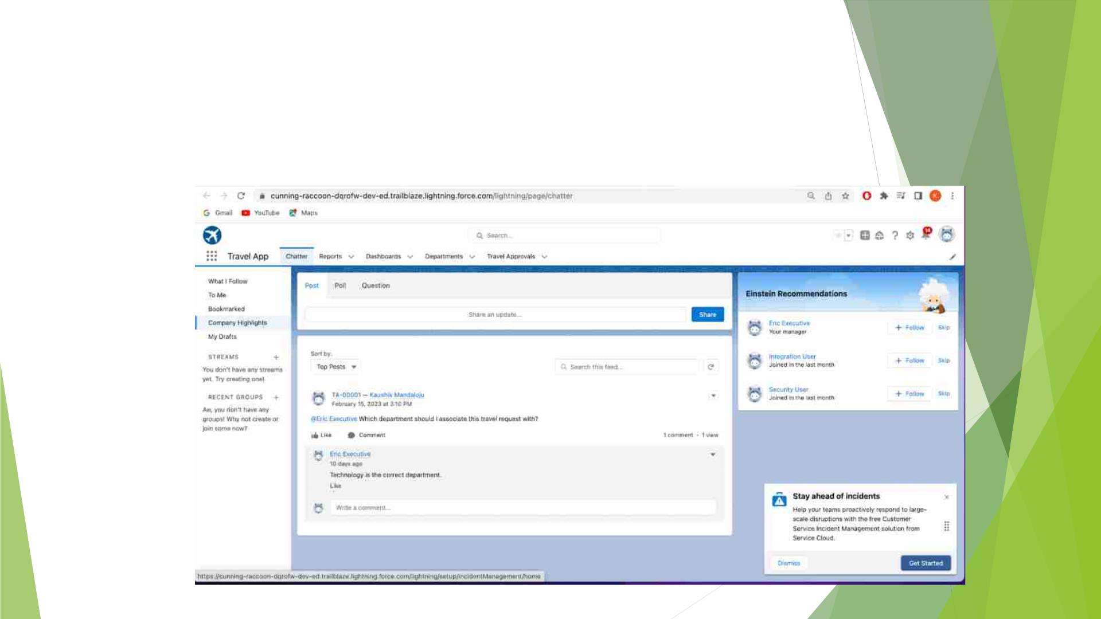
Module-1
Exercise-1
Creating Lightning App

Slide 6
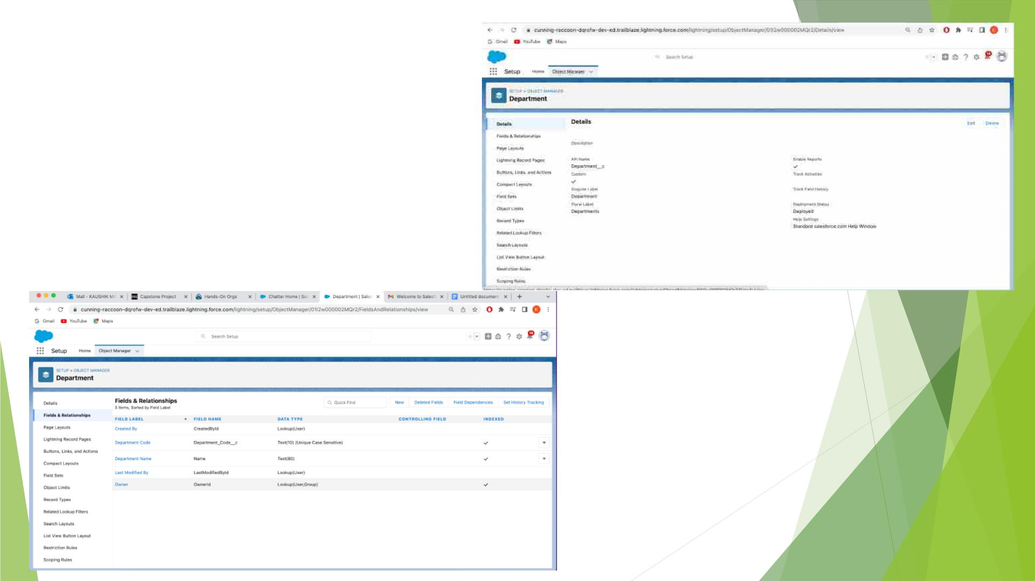
Created Department Custom
Object and Custom Fields

Slide 7
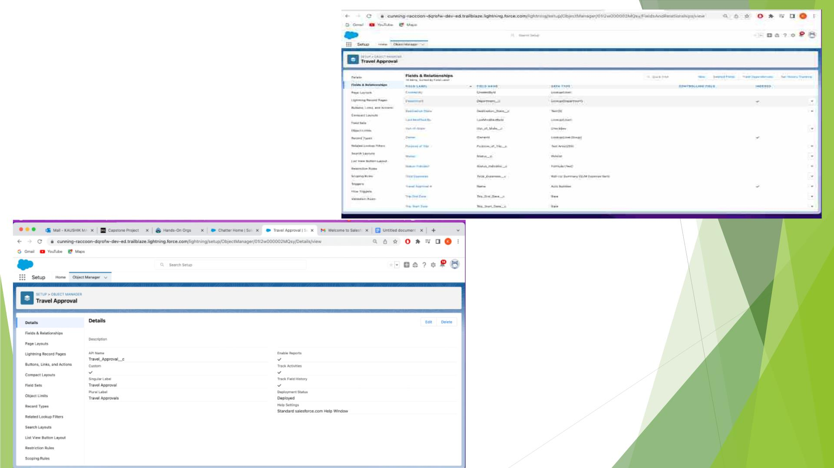
Created the required
Travel Approval
Object and Fields

Slide 8
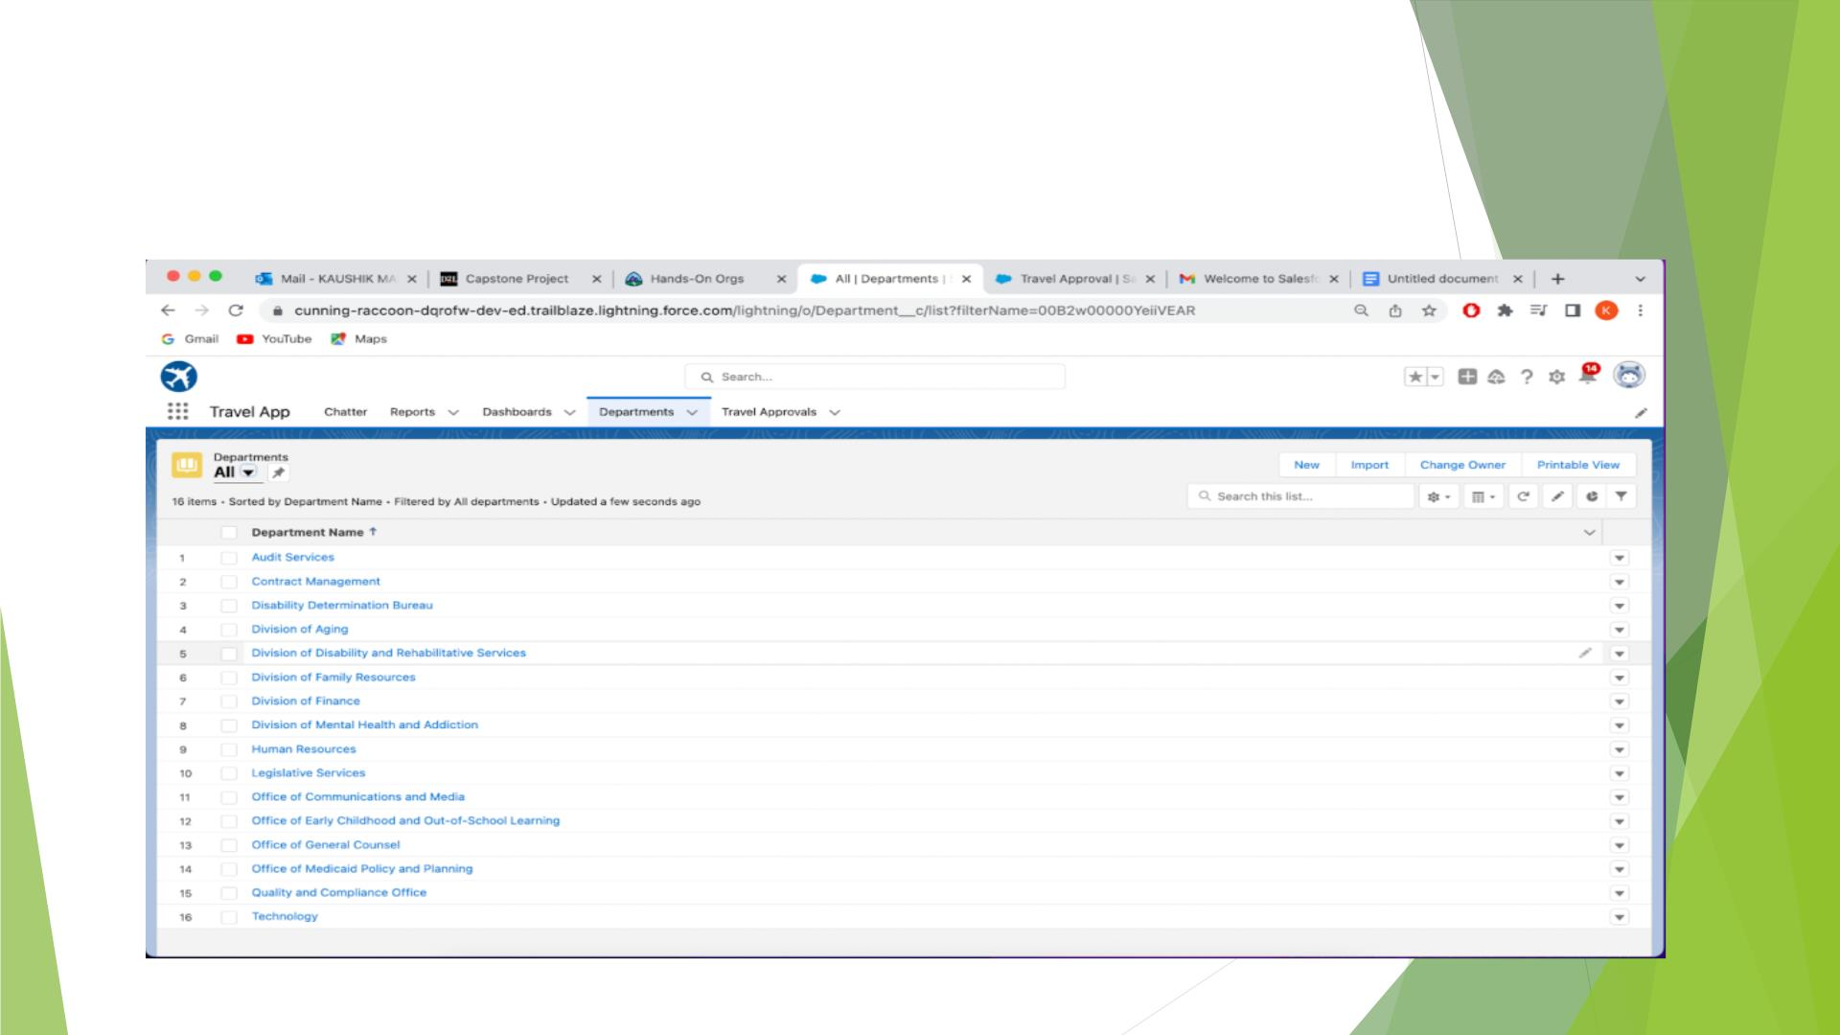
Imported Departments.CSV file using Data Import
Wizard

Slide 9
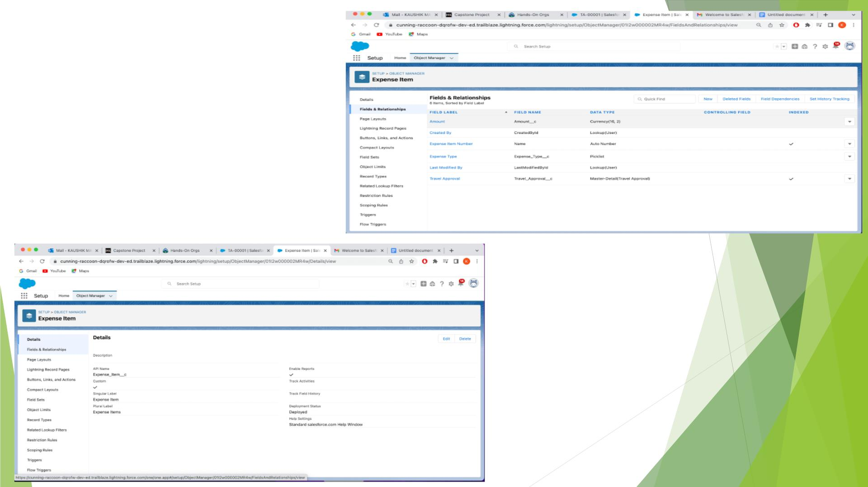
Exercise-2
Created Expense
Item Custom
Object and
Custom Fields

Slide 10
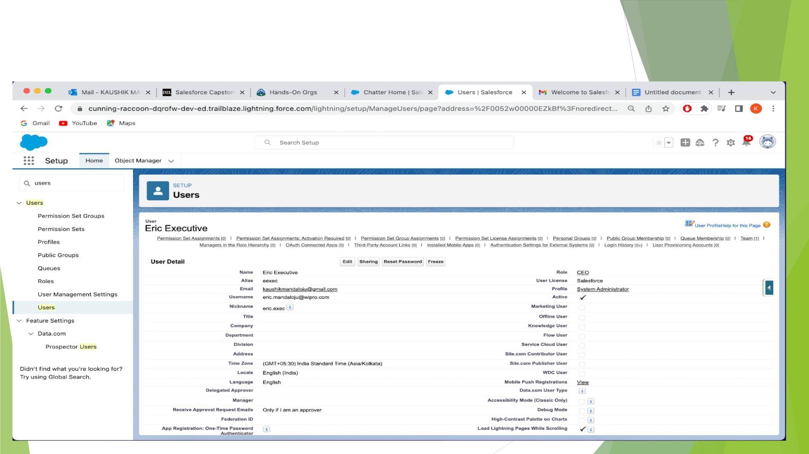
Created User Eric and added as system Administrator

Slide 11
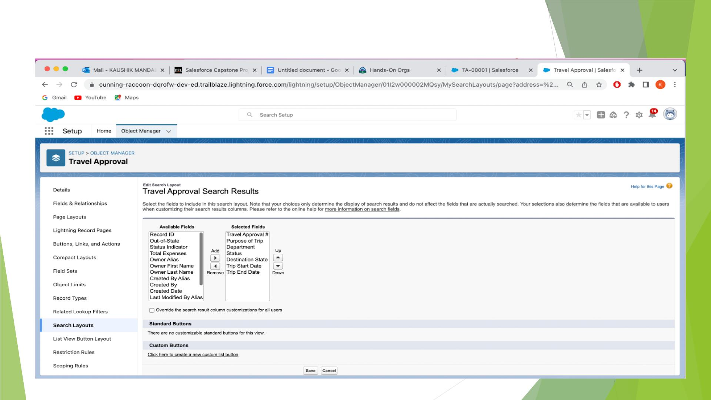
Customized the Travel Approval Default Search

Slide 12
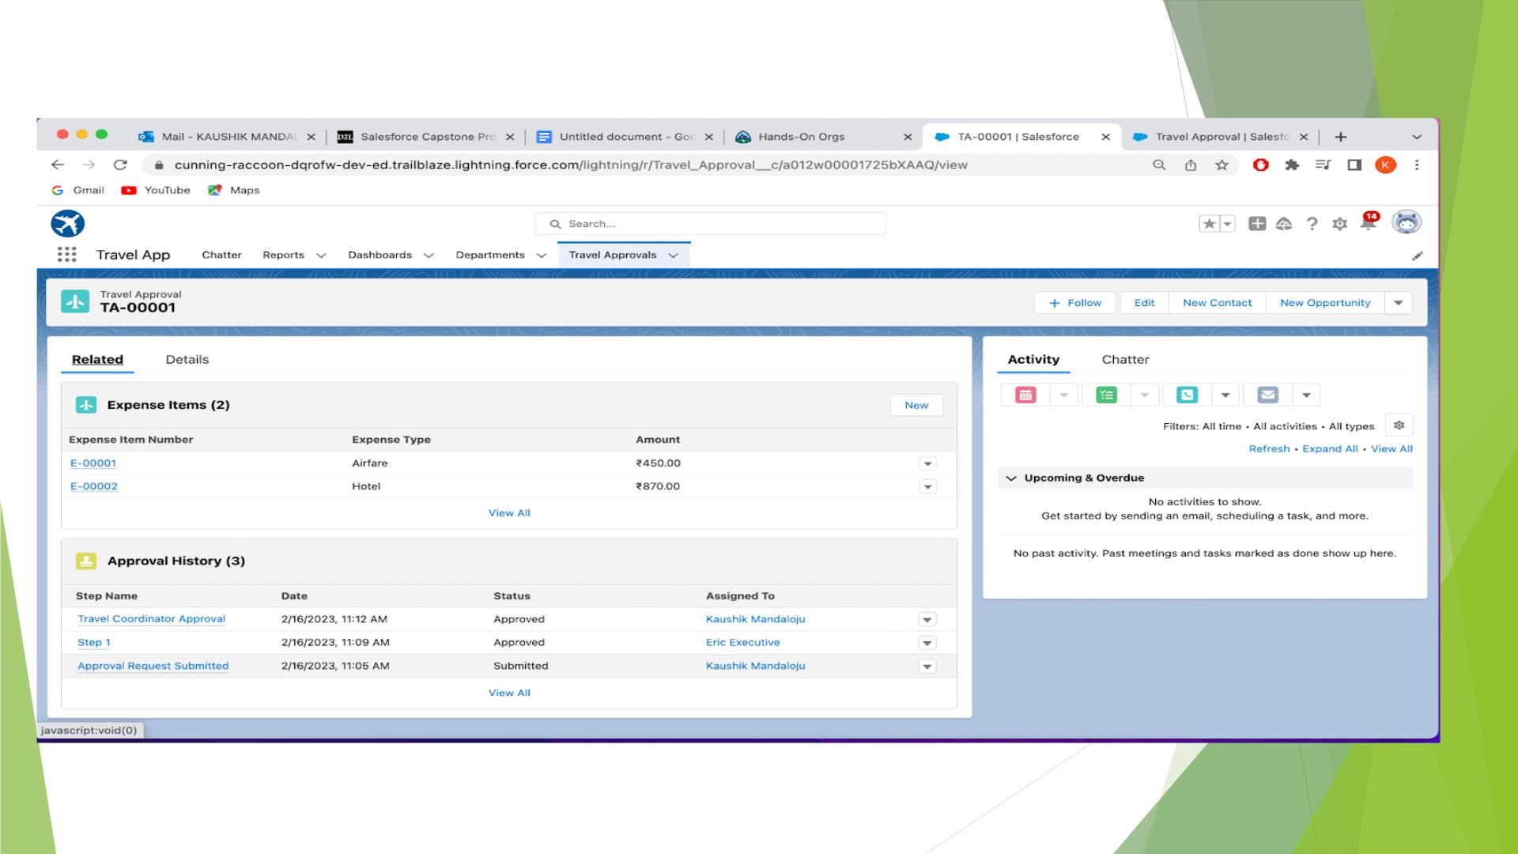
Customized the Travel Approval Page Layout.

Slide 13
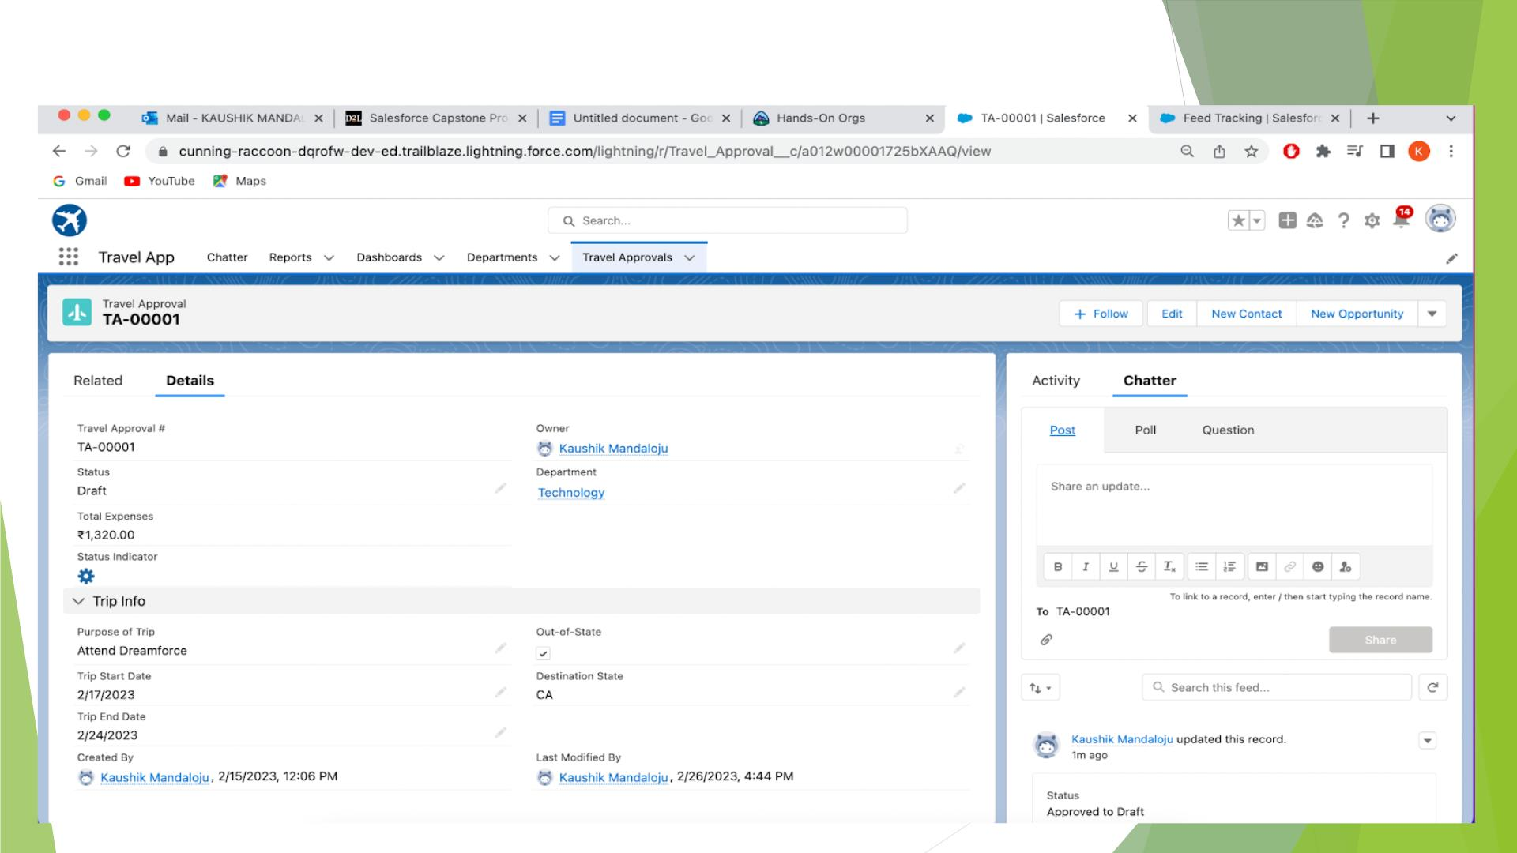
Overview of Travel Approval App

Slide 14

MODULE-2
◆ This Project module mainly focus on adding business logics and
analytics to improve the user experience
◆ It define Business logic using Validation rules, Roll-up summary
fields, Formulas, Flows & how to track Travel Approvals using
Reports and Dashboards

Slide 15
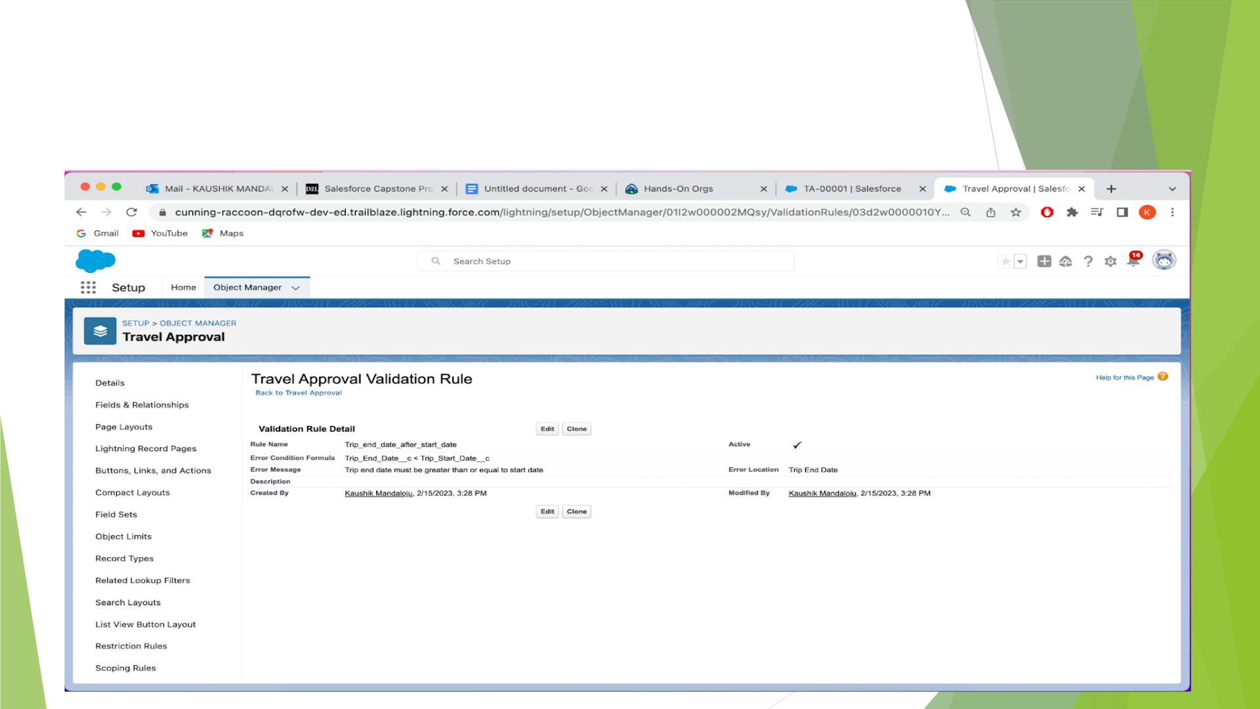
Created Validation rule
Trip End date must greater than Trip Start date

Slide 16
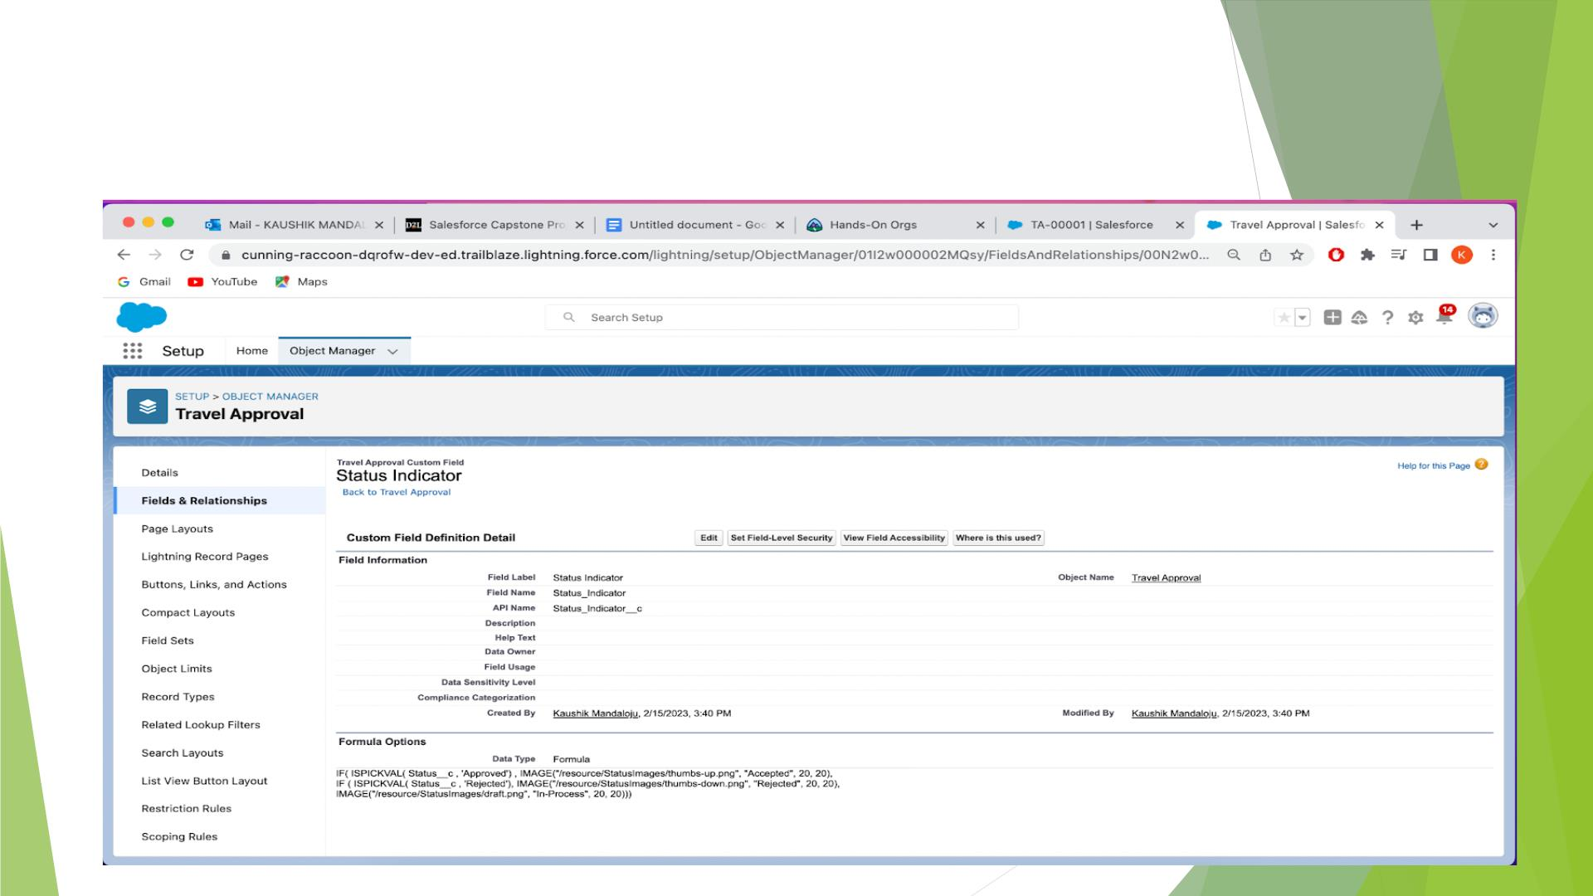
Created a Formula field on the Travel Approval
Object to show an image based on the status field

Slide 17
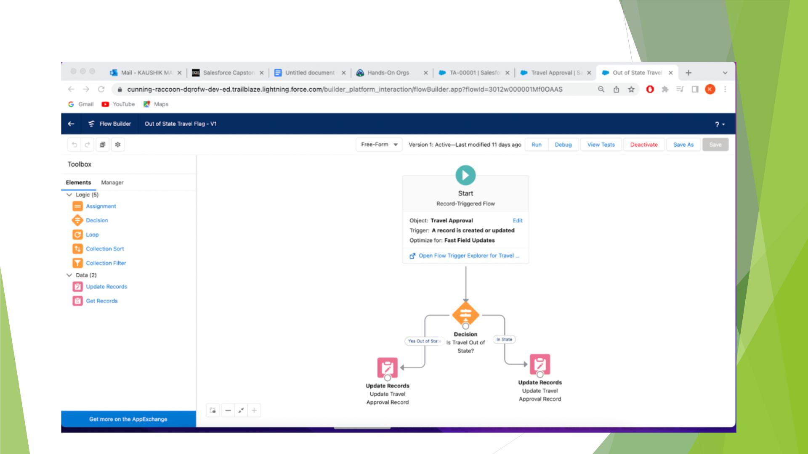
Create Record Triggered Flow ,Save and Activate

Slide 18
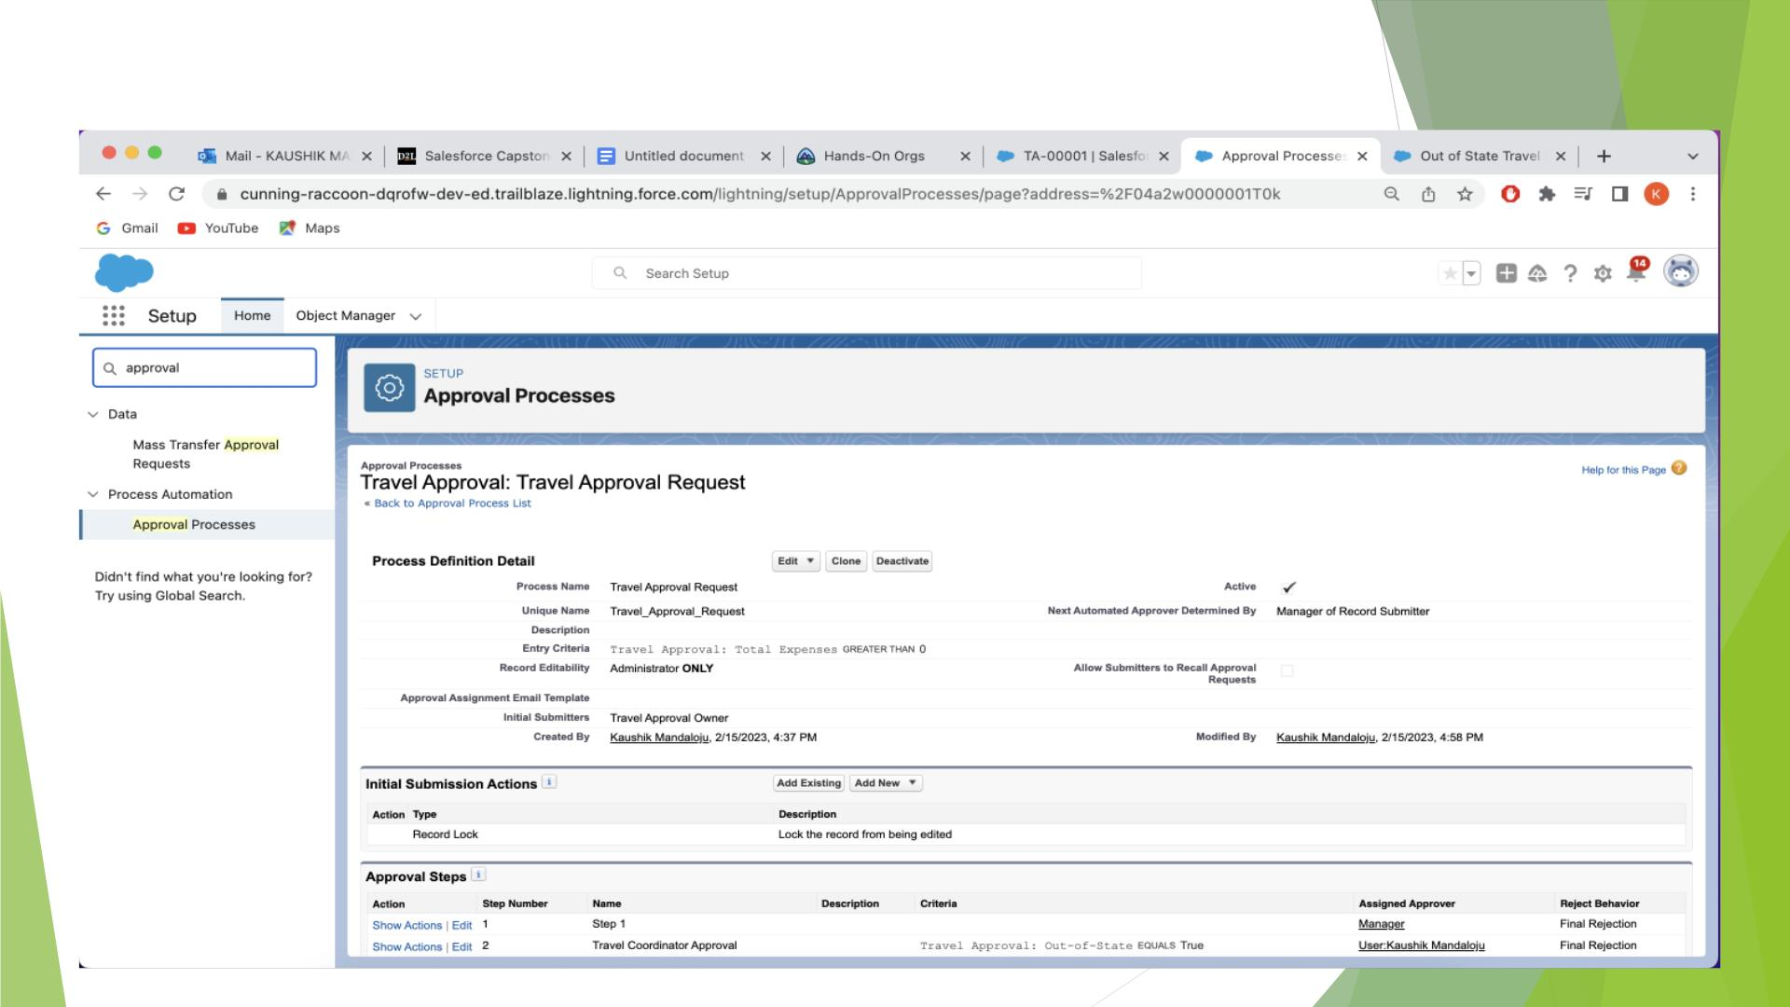
Created an Approval process for Travel Approval request.

Slide 19
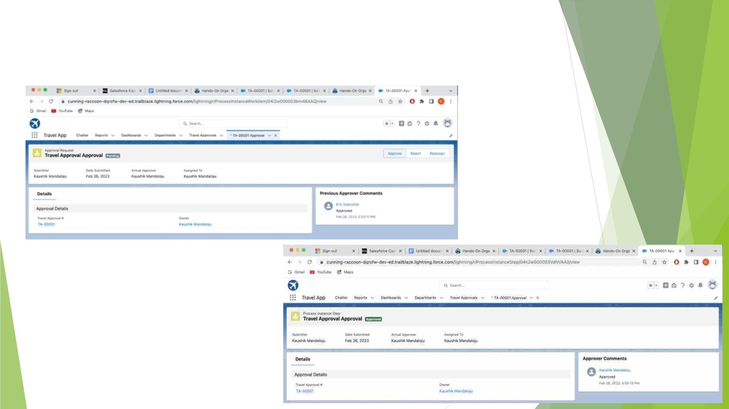
Testing the Approval Process Status is pending and
Submit for Approval

Slide 20
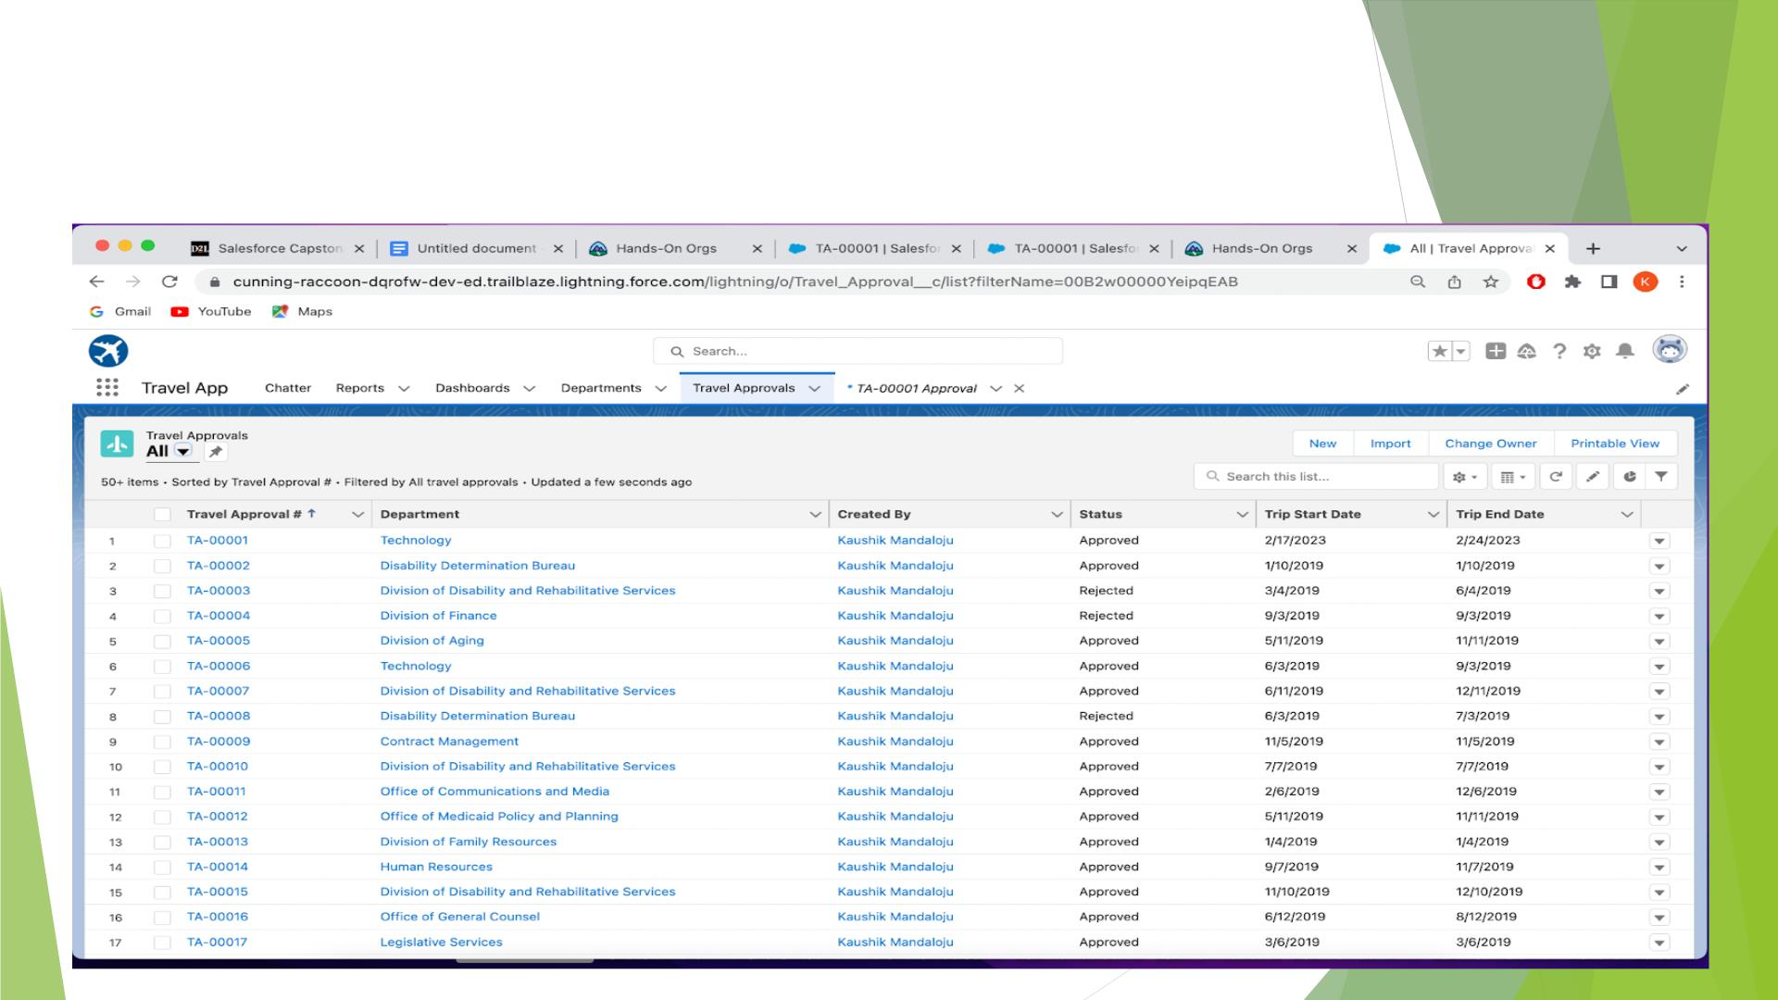
Imported Travel Approval Records Using Data
Import Wizard.

Slide 21
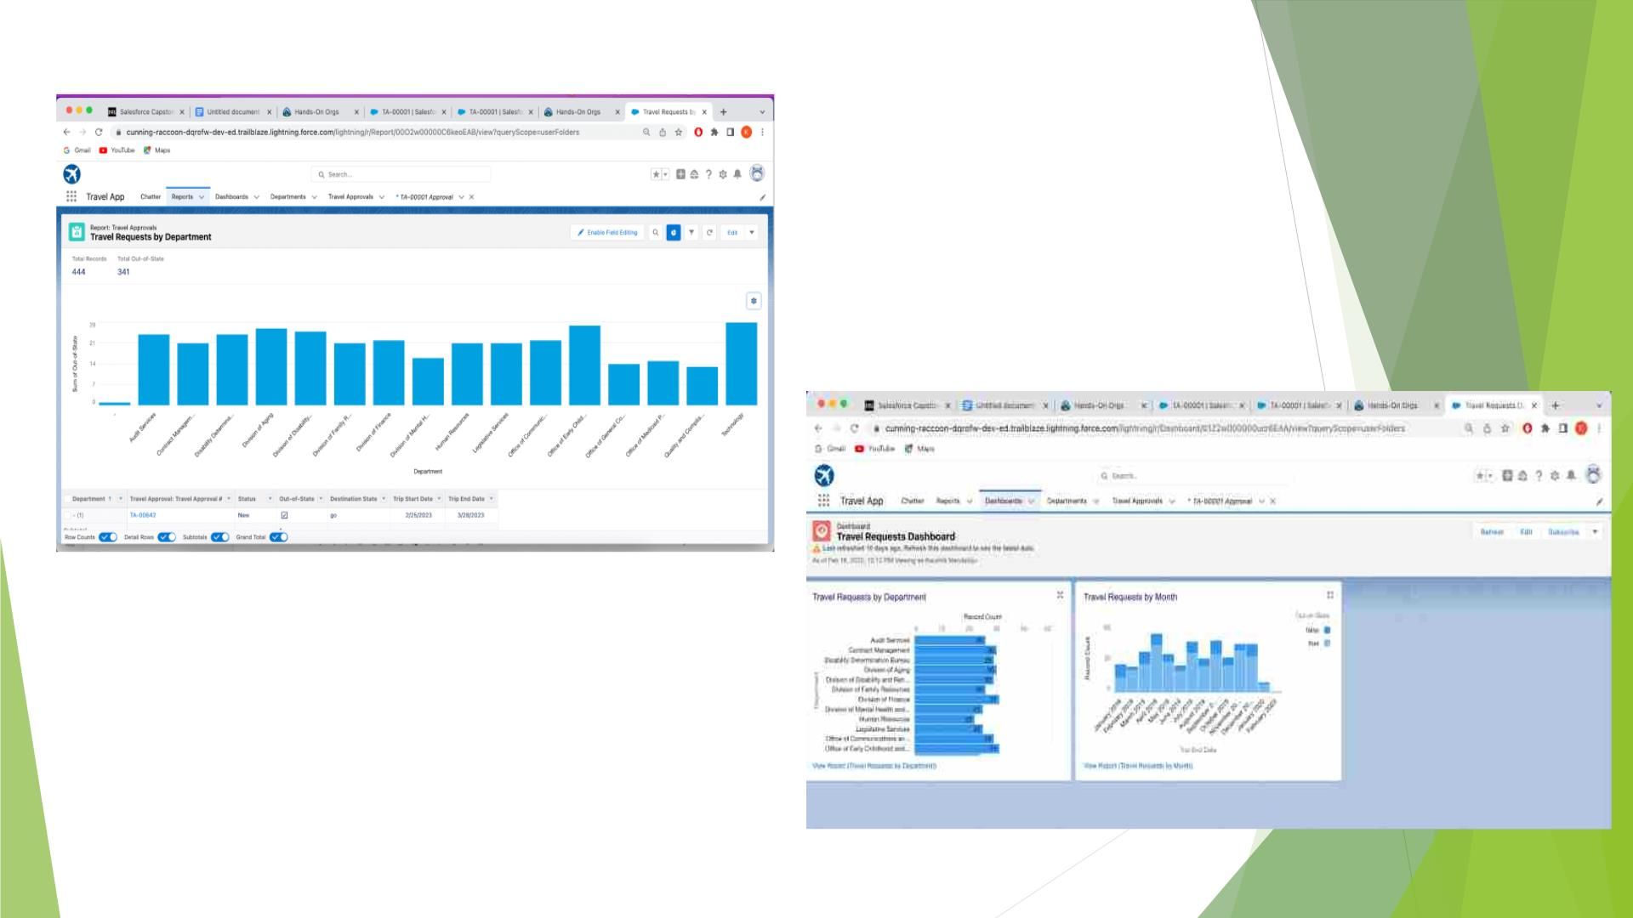
Created Travel Approval Reports and Dashboards

Slide 22

Module-3
This project module focuses on the coding approach to extend
the functional capabilities of your custom App.

Slide 23
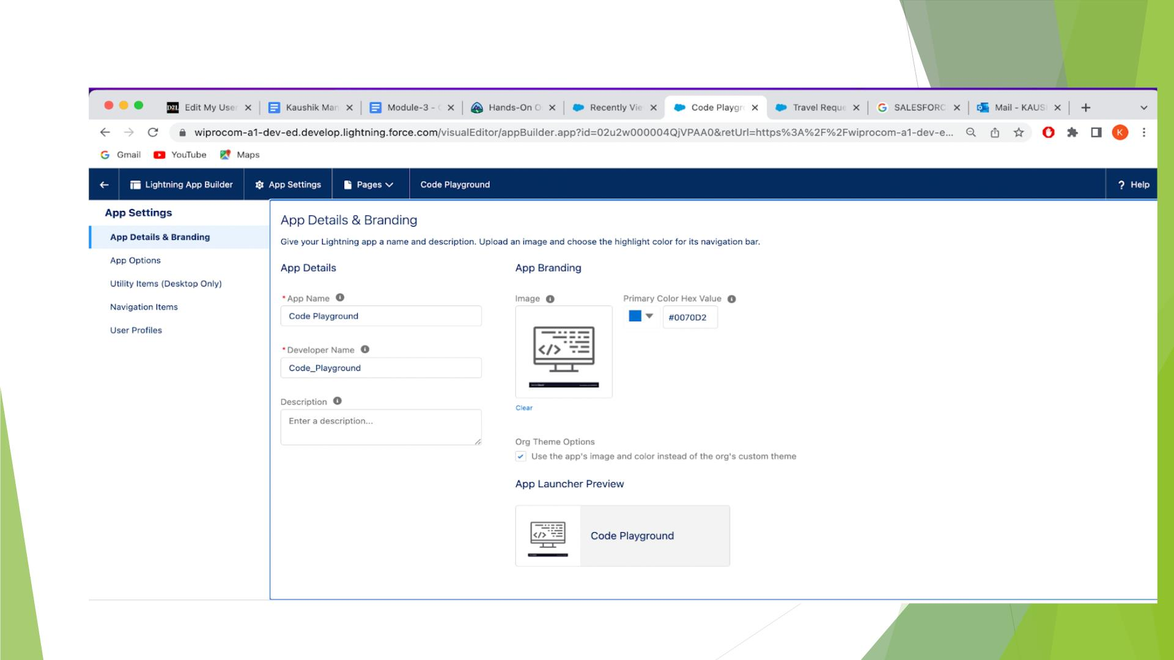
Create Code Playground App

Slide 24
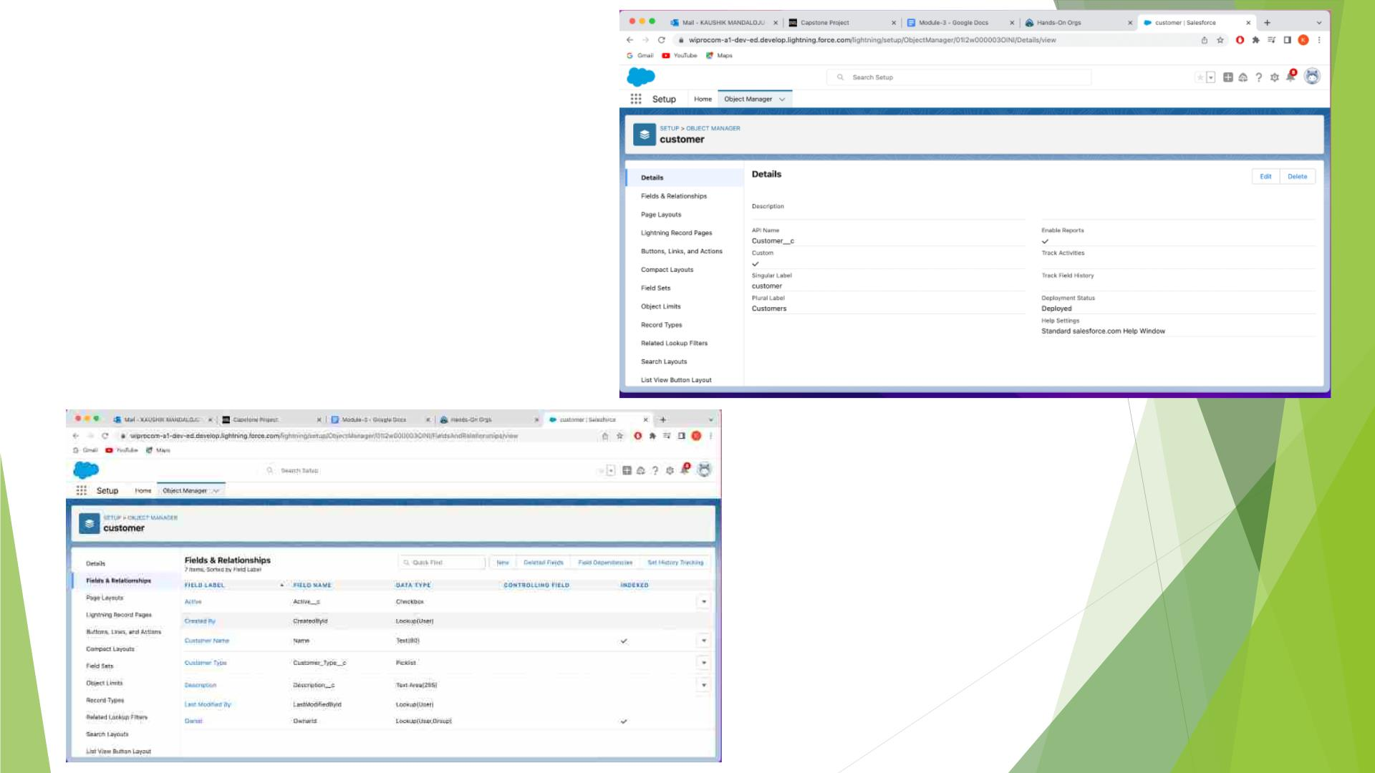
Created the
Custom
Object
Customer and
Custom Fields

Slide 25
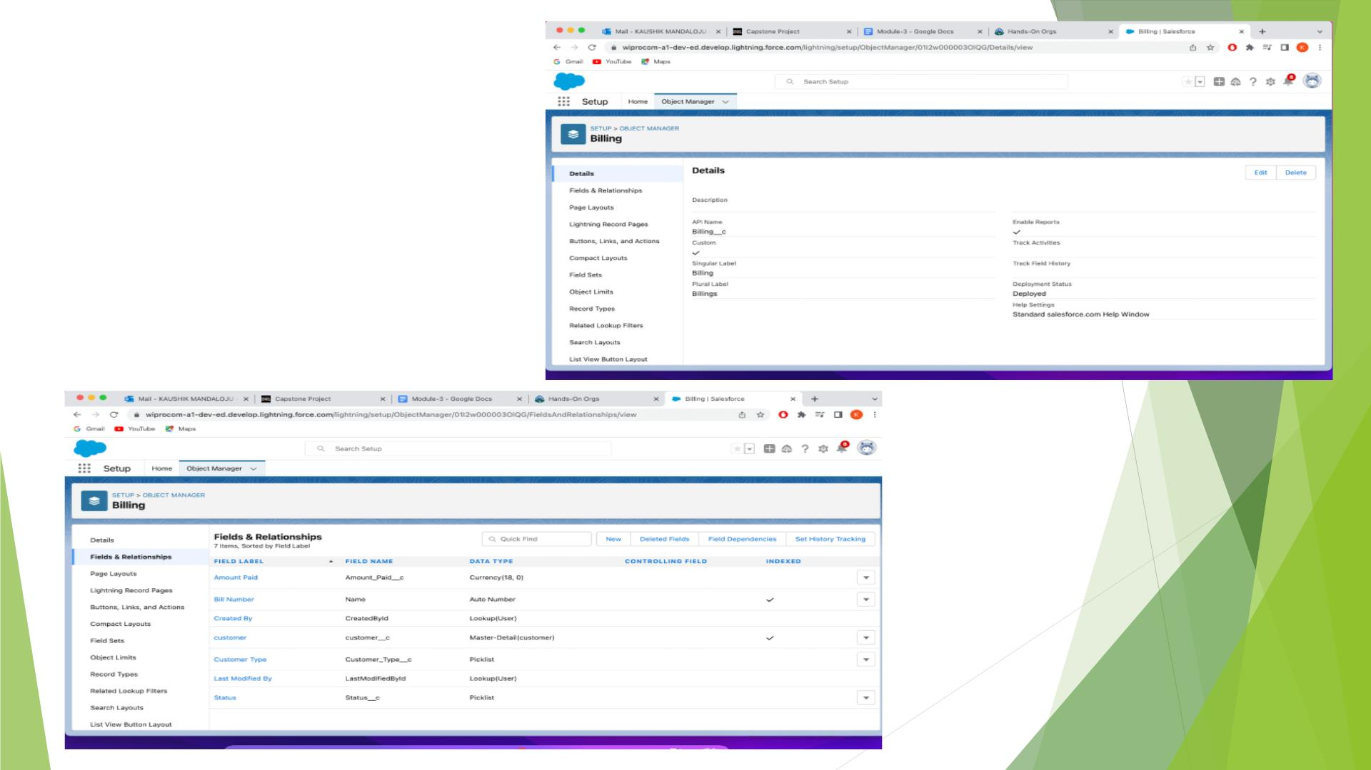
Created a
Custom Object
Billing and
custom Field

Slide 26
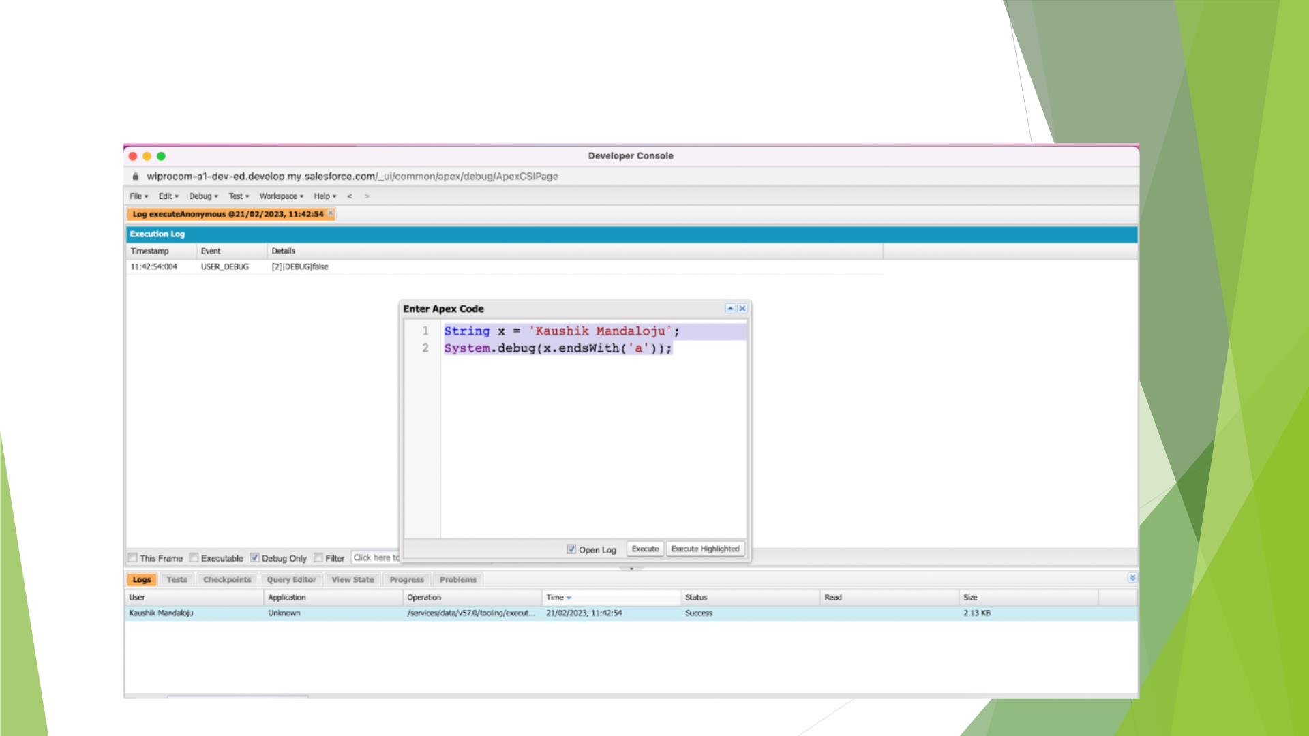
Exercise-2
Define a String Variable

Slide 27
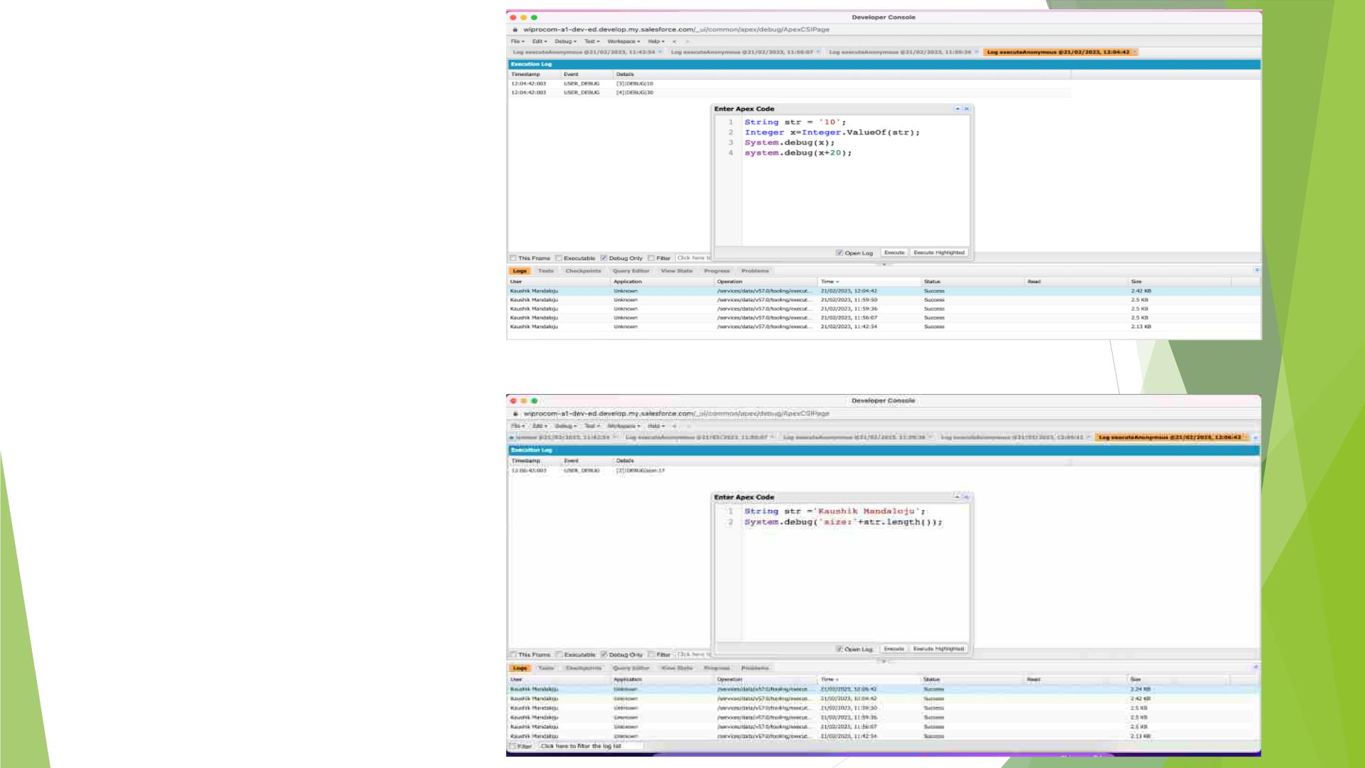
Display the Output
of an integer
variable from
string '10' and then
add 20 to it.
Used length
method to display
String length

Slide 28
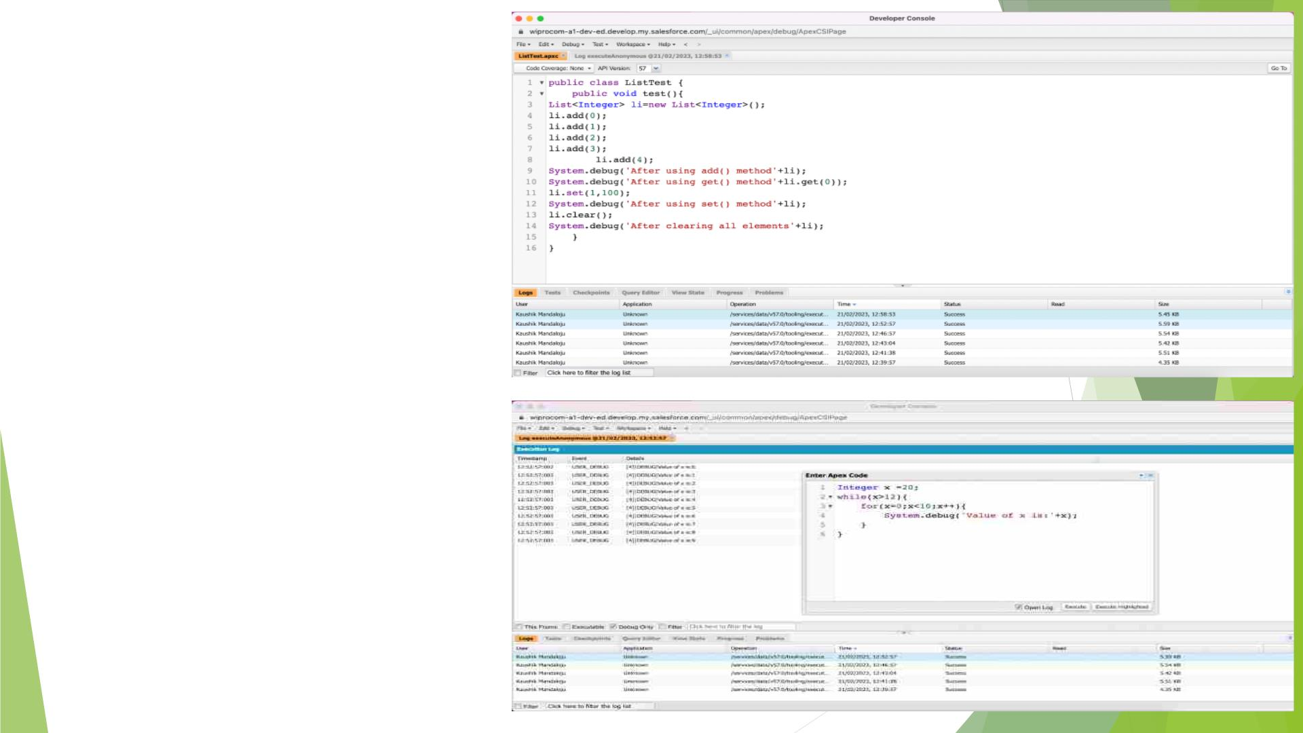
Defined a list and
displayed the
outputs using
different methods
Use Execute
Anonymous to
define and
execute the code
to display the
value of x=0 to 9

Slide 29
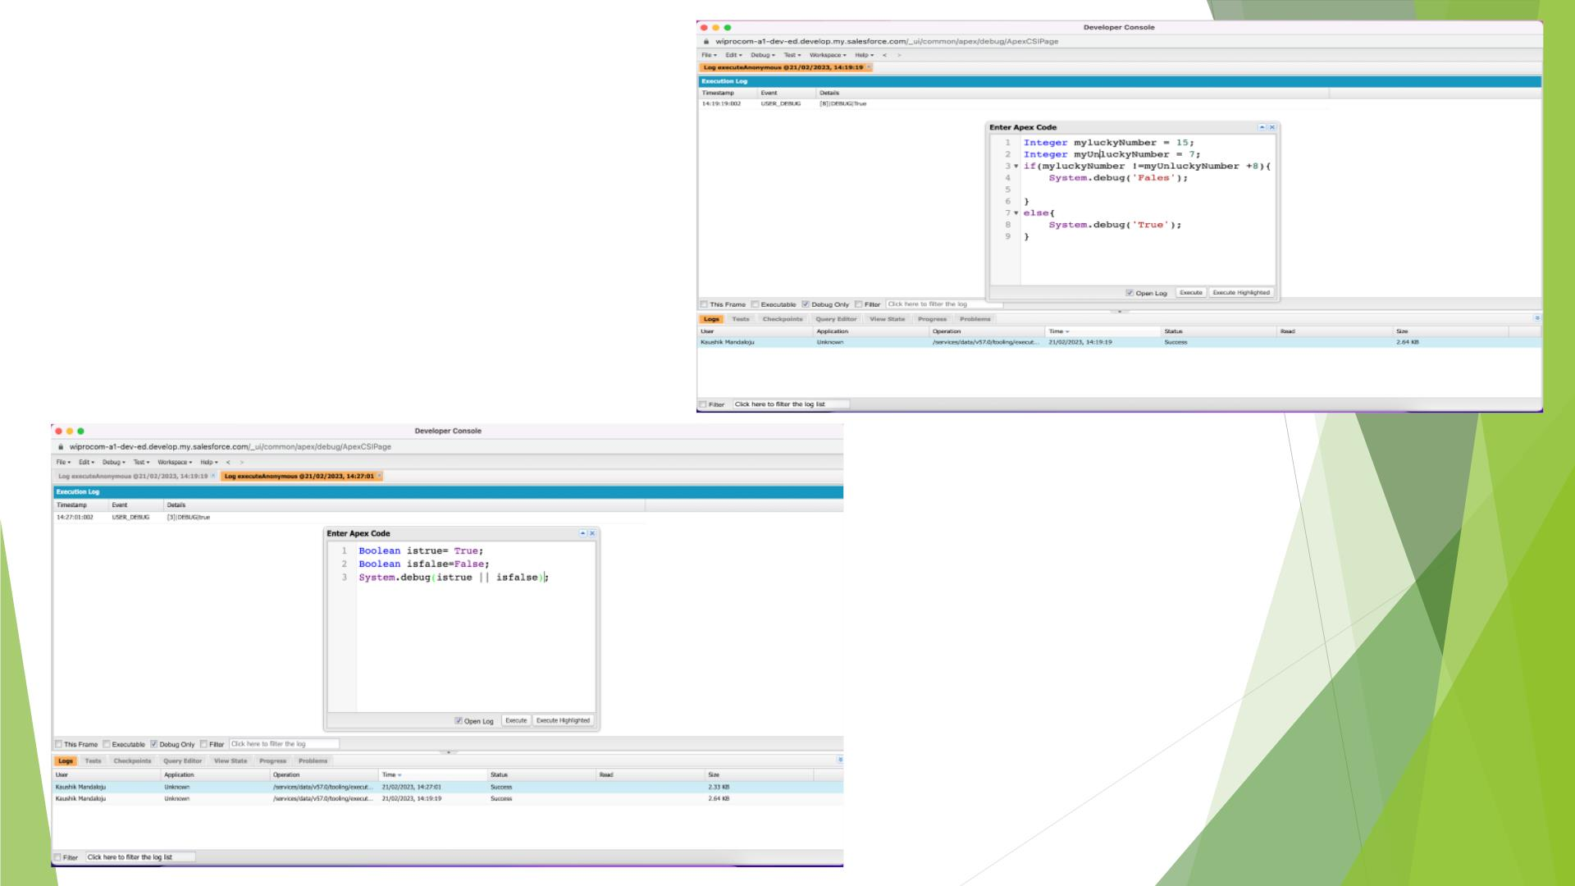
Answer the
following in
True Or
False

Slide 30
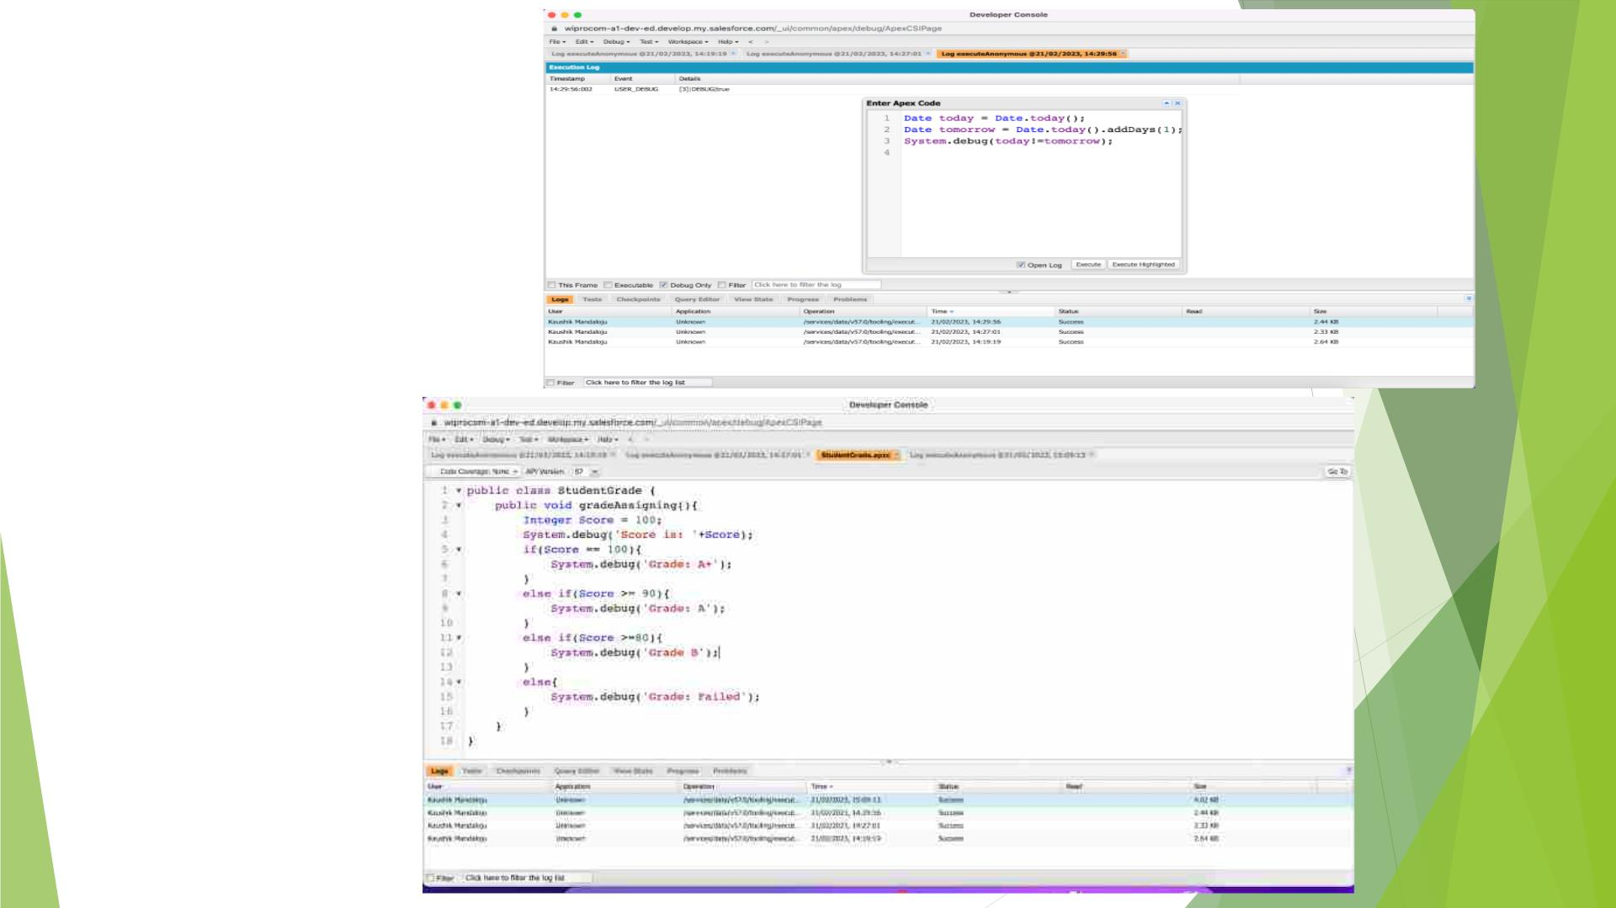
Answer
the follow
ing in True
Or False
Program
for
Finding
the Grade
based on
Score

Slide 31
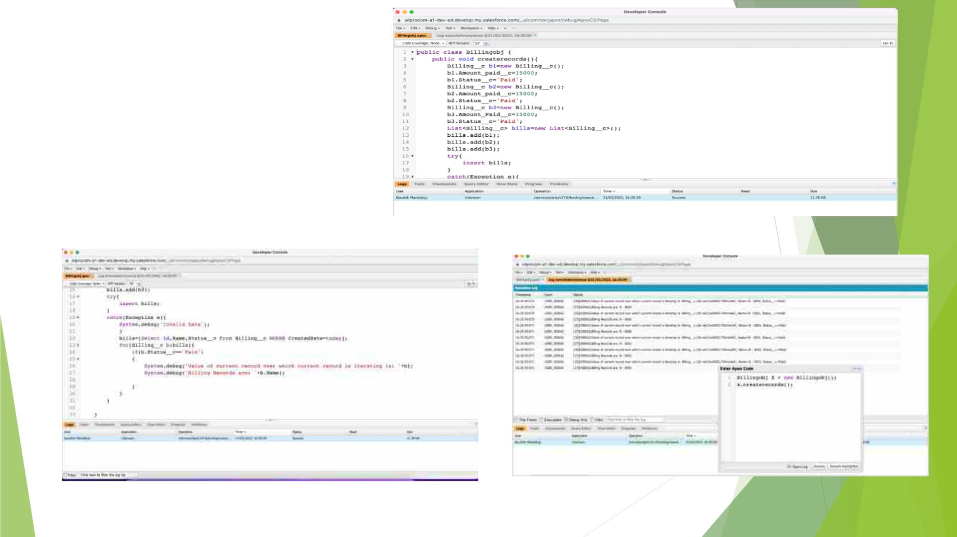
Program
to
execute
Apex - for
loop

Slide 32
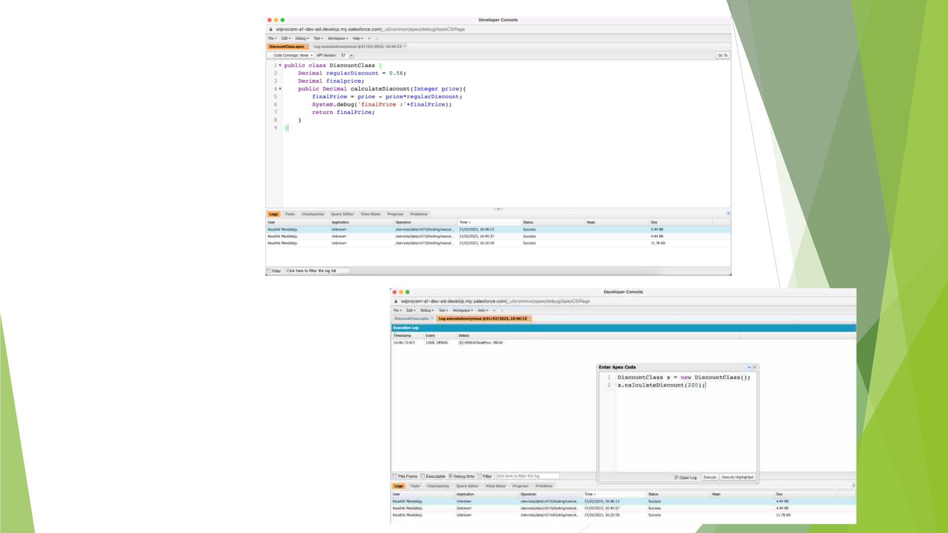
Created
a Class
to
demonst
rate
constant
s in Apex

Slide 33
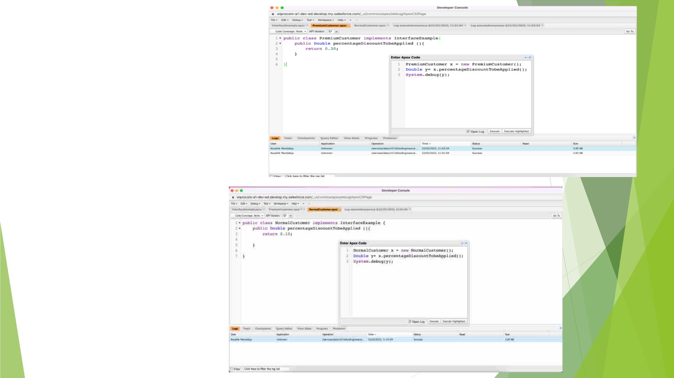
Create a
class to
demo the
use of
interfaces
in apex

Slide 34
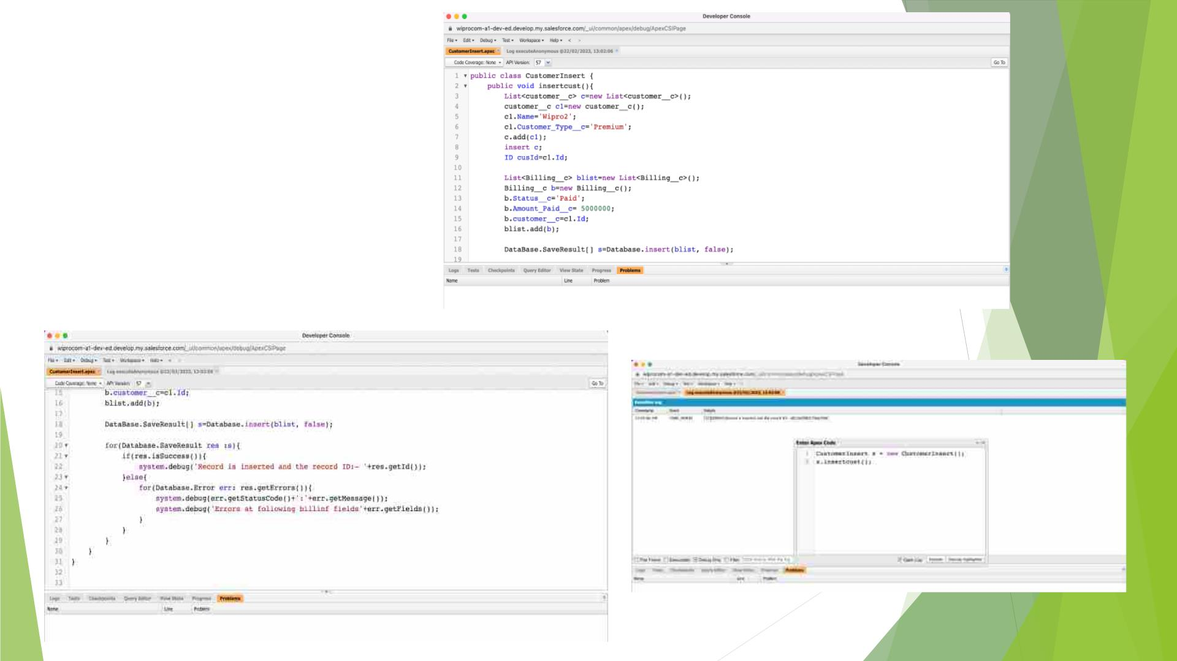
Demo on DML
Insert Operation
Using Database
Methods

Slide 35
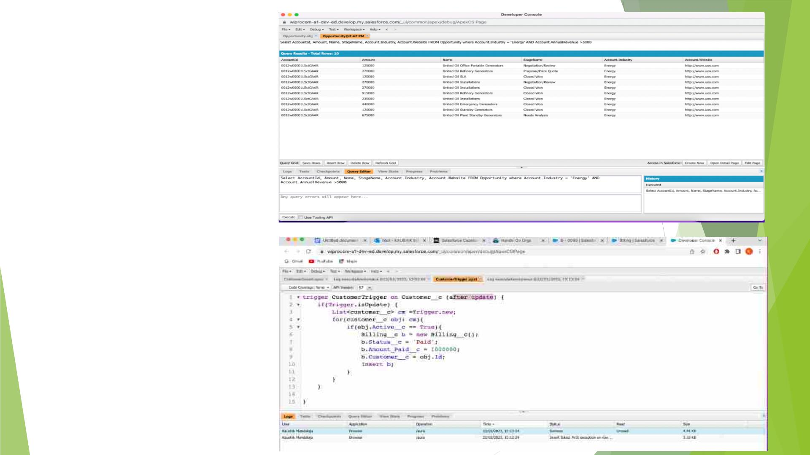
Displaying
Records
According to
the required
conditions
Created a
Trigger for
Billing Named
Customer
Trigger

Slide 36
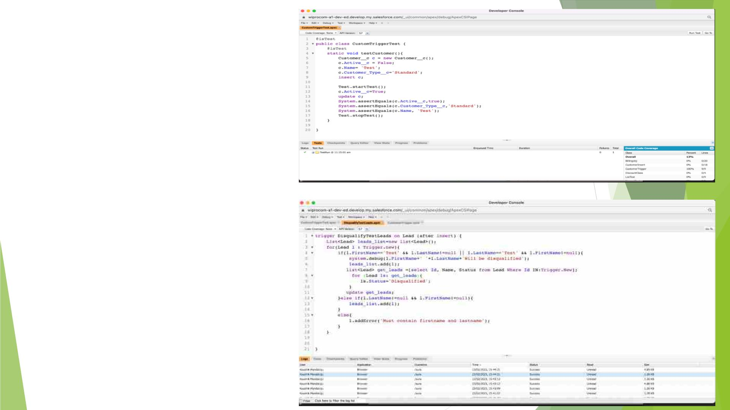
Created a Test class
for CustomTrigger
Created a Trigger
for Leads Named
DisqualifyTestLeads

Slide 37
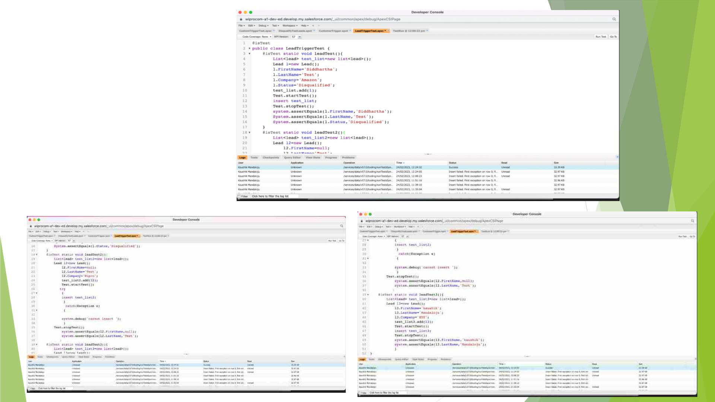
Created a
Test class
for
Disqualified
TestLeads
trigger

Slide 38
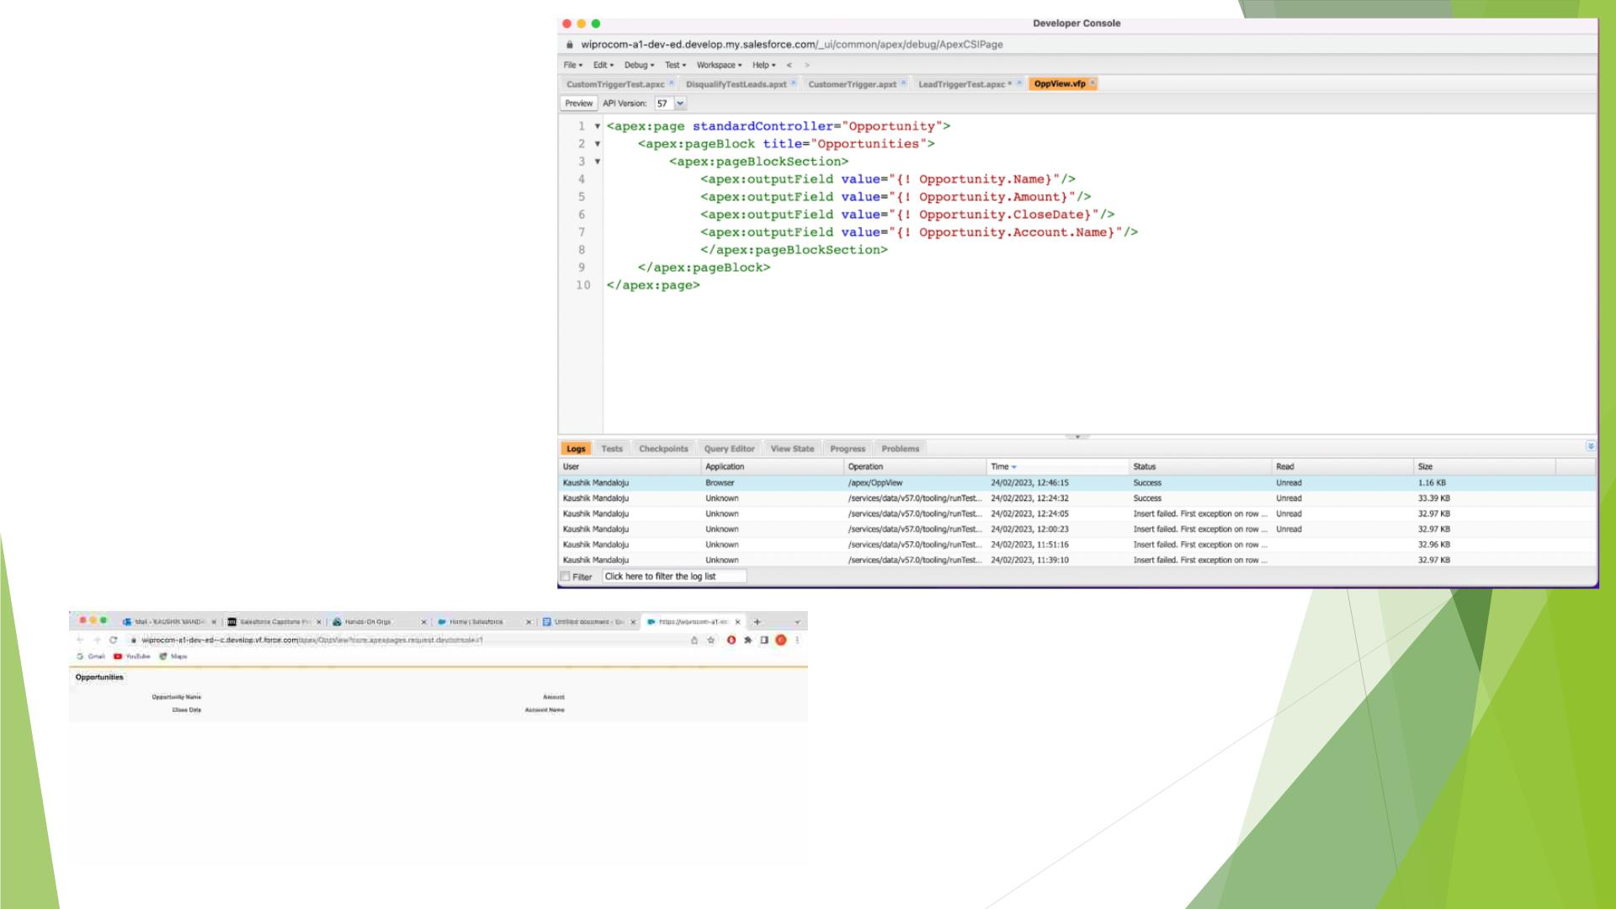
Created a
Visualforce
Page
OppView and
displayed
four apex:
outputfields

Slide 39
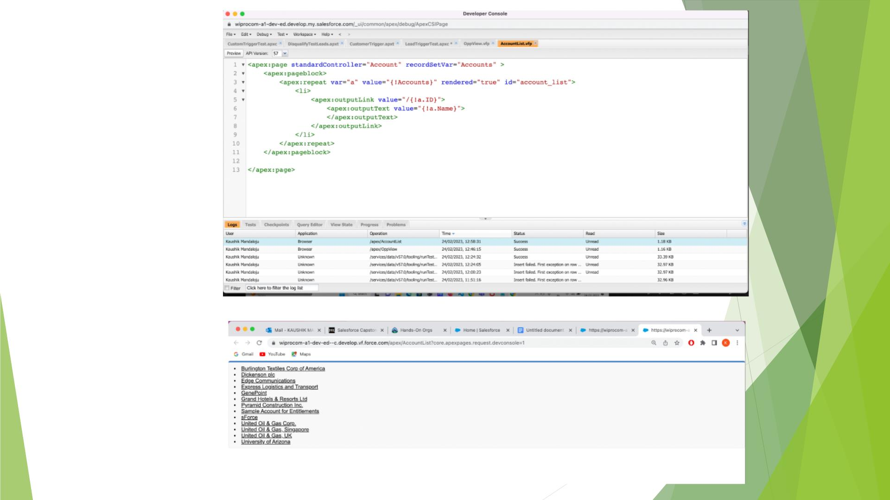
Created a
Visualforce
page that
shows a list
of Accounts
linked to
their record
pages

Slide 40
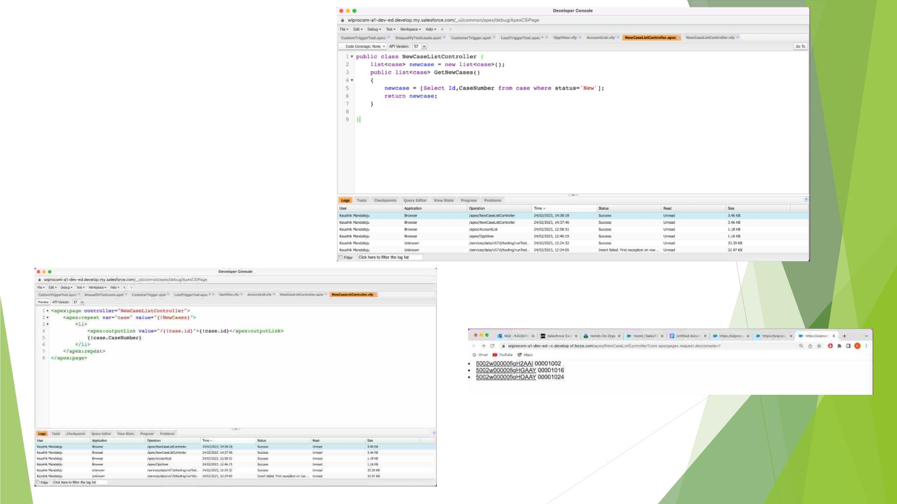
Created a Vf
page that uses
an Apex class to
display a list of
cases with the
status of ‘New’

Slide 41


